Slide 1
Data Science and Machine Learning with Python – Hands-On!

Slide 2
Types of Data
Numerical
  Represents some sort of quantitative measurement
    Examples, Height of people, page load times
  Discrete Data
  Continuous Data
Categorical
  Quantitative data that has no inherent mathematical meaning
    Examples: Gender, Yes/No, Product Category
  You can assign numbers to categories in order to represent them more compactly, but the numbers have no mathematical meaning
Ordinal
  A mixture of nuermical and categorical
    Categorical data that has mathematical meaning
  Example
    movie ratings on a 1-5 scales
    These are number from 1 to 5 , but have meaning 5 is the best

Slide 3
Mean, Median, Mode
Mean – Average – Sum / Numbers
Median – Sort the values and take the value at the midpoint
  Sort the values and take the value at the midpoint
  even – take the average of the two in the middle
  Medina is less susceptible to outliers than the mean
    Example : Income in America
      The mean is 2,000,000
      The median is about 51,000 which is closer to the truth.
Mode
  The most common value in the dataset
    Not relevant to continuous numerical data
    Only works with discrete data / Categorical data

Slide 4
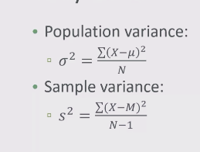
Standard Deviation and Variance
The spread of the data and the shape of the distribution
histogram : Look up the bucket of data and retrieves the frequency
  where a bucket can be arrivals per minute
variance – how spread out is the data
  average of the squared difference from the mean
  square the difference so that both positive and negative variance don’t cancel each other out and give more weight to the outliers
Standard Deviation – Usually talk about this more
  Data points that lie more than one standard deviation from the mean can be considered unusual
  How many standard deviations away from the mean it is.
Population vs Sample
  Population compete set of variance
  Sample Data – Divide by the number of samples - 1 for the variance

Slide 5
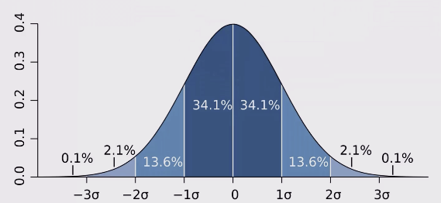
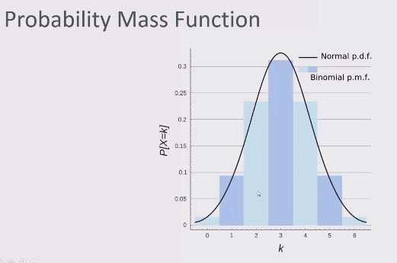
Probability Density Function; Probability Mass Function
Probability Density Functions
  A given range of value occurring
  The probability of a specific value happening is very small very close to never
  happening
Probability Mass Function
  The probability of a range of discrete values

Slide 6
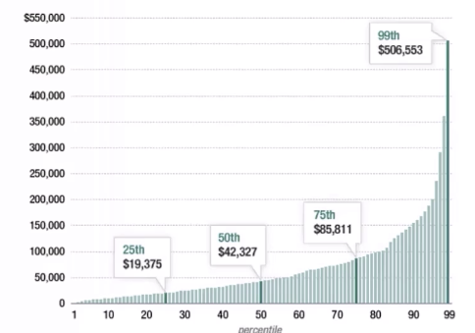
Percentiles and Moments
Percentile
  In a data set what is the point at which X% of the values are less than that value
  Example Income distribution
    99% make less then 506,583
    The 50% is median

Slide 7
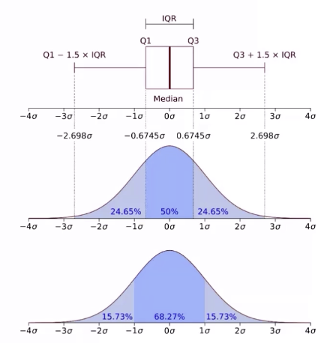

Percentiles and Moments
Percentiles in a normal distribution
  Quartiles contain 50 percent of the data where each side of the median contains 25%
  of the data
  Inter Quartile Range – The Area where there is 50% of the data
  50th percentile is just another phrase for median
Moments
  Quantitative measures of the shape of a probability density function
  Ways to measure the shape of a data distribution
  The first moment is the mean
  The second moment is the variance

Slide 8
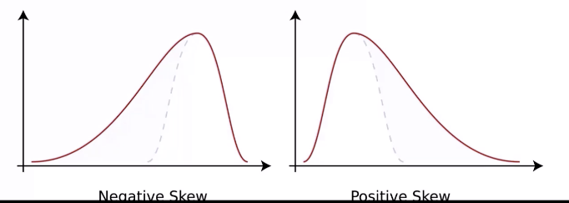
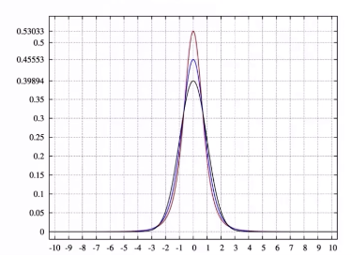
Percentiles and Moments
The third moment is the skew
  How lopsided is the distribution
  A distribution with a long tail on the left will be skewed left
  and have a negative skew
The fourth moment is kurtosis
  How thick is the tail and how sharp is the peak compared
  to a normal distribution
  Higher peaks have higher kurtosis

